Slide 1
A short lesson on the history of the Virginia National Guard
Notes:
The Colonial Era (1607-1774): During the colony’s first 168 years, many Virginians served in the militia formed to protect the various towns and counties. In 1644 free-black colonists (mostly former slaves) were also allowed to enlist in the militia. Today the 276th Engineer Battalion carries the oldest continuous lineage from that period. During the French and Indian War (1755-1763) George Washington, served as a Lieutenant Colonel of the Virginia Regiment.
The Revolutionary War (1775-1783): With the beginning of the Revolution in 1775, most of the Virginia militia volunteered to fight the British. George Washington was appointed as the commander of the Continental Army and other Virginians soon became well-known military leaders: Daniel Morgan, George Rogers Clark, Hugh Mercer, and “Light Horse” Harry Lee. Four men who served in the Virginia Militia would later become President: George Washington, Thomas Jefferson, James Madison, and James Monroe.
The War of 1812 and War with Mexico: Once again Virginia supplied men and arms to defend the country and the state. The Virginia Military Institute (VMI) was established in 1839. During the 1854 War with Mexico, Virginia provided a Regiment of Volunteers to serve with the US Army.

Slide 2
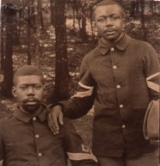
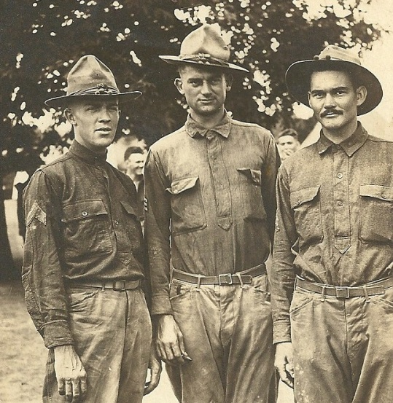
A (very) Short History Lesson
Civil War: April 1861 – May 1865.
The Stonewall Brigade: 2nd, 4th , 5th, 27th, 33rd Virginia Regiments
1871 Reorganization:
2nd and 3rd Virginia Volunteers
Spanish American War: April - December 1898
2nd and 3rd Virginia Volunteer Infantry Regiments
Notes:
A short history:
The Civil War (1861-1865) and Spanish American War (1898-1899): Virginia joined the Confederacy on 17 April 1861. The most famous Virginia Guardsman of the war was Thomas Jackson. From his brigade’s heroic stand at the Battle of Manassas the title of “Stonewall Brigade” was awarded to the Virginia Militia and still used today for the 116th Infantry. Robert E. Lee surrendered the Army of Northern Virginia at Appomattox Court House on 9 April 1865. After the Civil War the country and state were at peace until the Spanish American War. Virginia provided regiments of militia including, for the first time, a regiment of African-American militia. After the wars, Virginia militiamen served in state duty for riot control and law enforcement.
Points to note
1. For many years, the 116th retained the nickname of the Stonewall Brigade but this will be changing to reflect the movement away from Confederate/Civil War names and symbology.
2. Virginia is one of the few states that had African American National Guard units and the armory for the Richmond units is still standing today as the African-American History Museum on Leigh Street.

Slide 3
1916 Defense Act
Established uniformity in periods of enlistment, conformity to Federal regulations, and established a dual oath of allegiance to the Federal and the State government. It also allowed Guard officers to serve in higher ranking positions than previously permitted and it provided for the addition of more tactical units.
The legislation also called for a standard pay scale. Under these guidelines, generals received $16.67 a day while second lieutenants, the lowest ranking officers, received $4.72. Among the enlisted ranks, a private received 60 cents a day and the sergeants earned a full dollar.
The National Defense Act mandated that the term National Guard be used to refer to the combined network of states’ militias that became the primary reserve force for the U.S. Army.
But meanwhile, on the Mexican border…
Notes:
Modern National Guard (1903-1916):
During the Spanish American War many problems in the existing State Militia system became obvious to all. In 1903 Congress enacted the first of several laws changing how the volunteer system would function. Among the provisions was a mandate that Guardsmen had to drill a minimum of 48 periods a year along with 15 days of “annual training.” Enlisted men were now issued standard army uniforms and were trained to Army standards. As a requirement of the law the “Virginia Volunteers” designation was changed to “Virginia National Guard”.
Points to note:
This act made the pay and rank scale for the State’s national Guard units the same as active duty units
2. From this point on the term “militia” will no longer be used.

Slide 4
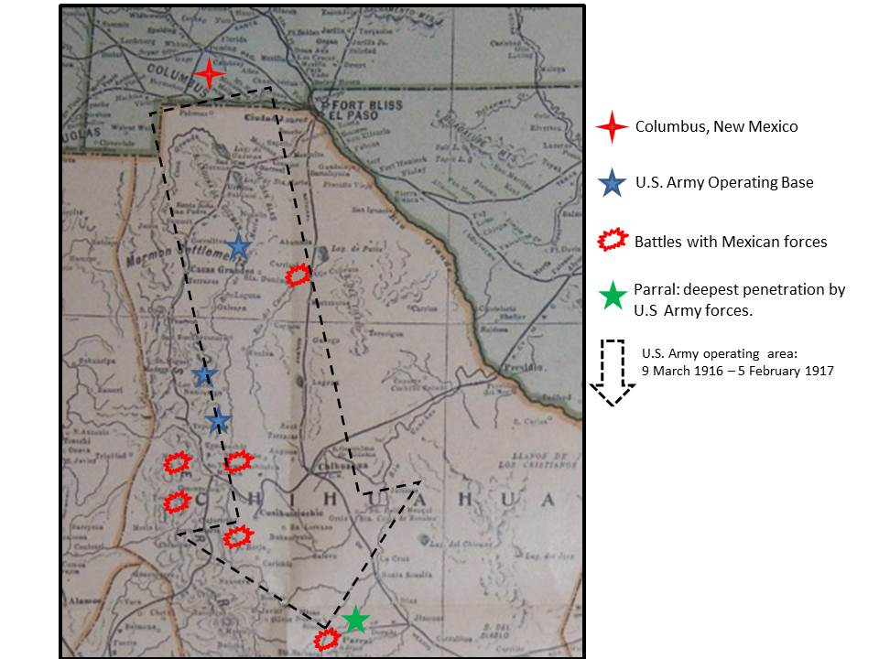
Notes:
On 9 March 1916 Mexican bandits raided Columbus, N.M., and then fled back over the border. President Woodrow Wilson ordered the Army to pursue them into Mexico and later mobilized 100,000 National Guardsmen to patrol and protect the border against further raids. From Virginia came two infantry regiments, a battalion of field artillery, one cavalry squadron and companies of engineers and signal troops, for a total of 4,000 men. In early 1917 the Virginia units returned home after serving six months on the border.
General John J. Pershing led the US Army into Mexico to track down Pancho and his band.
Furthest penetration into Mexico was 550 miles.

Slide 5
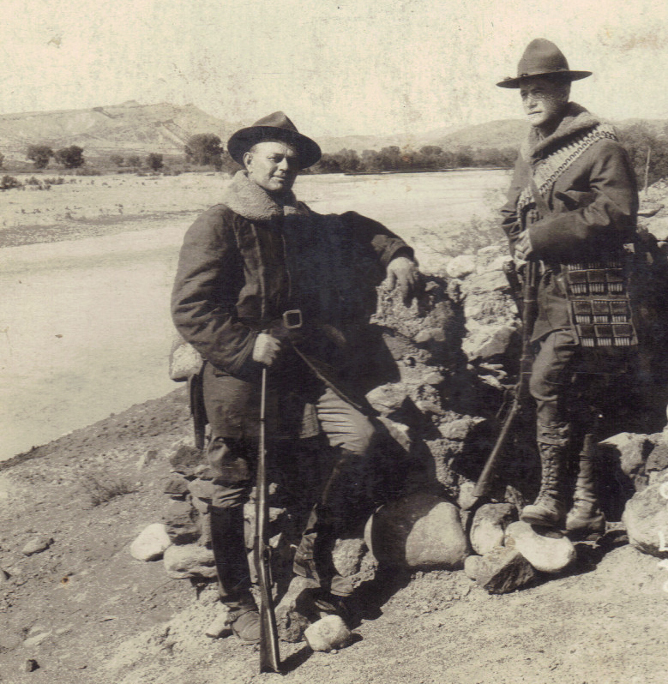
But the cross –border raids continued
So the National Guard units from Texas, Arizona and New Mexico were activated:
-5,000 more soldiers
but almost all
infantrymen….
Captain McNarny (6th US Cav)
and Lieutenant Elbert (4th Tex Inf)
on the Rio Grande.
Notes:
The National Guard units from the border states were mobilized but more troops were needed.

Slide 6
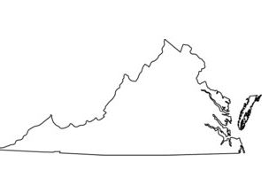
Virginia
Virginia could send Infantry, Field Artillery, a newly formed Cavalry squadron, and companies of engineers and signal troops:
1st and 2nd Infantry Regiments
1st Field Artillery Battalion
Independent Battery C of Field Artillery
Co A Engineers
Co A Field Signal
and the 1st Virginia Cavalry Squadron (RLIB)
All total, some four thousand Virginians deployed to camps in southern Texas near the Mexican border.
Notes:
When Virginia was mobilized to serve on the border all of the units in the state except for the Coast Artillery units were activated and sent to the border in Texas.
From Virginia came two infantry regiments, a battalion of field artillery, one cavalry squadron and companies of engineers and signal troops, for a total of 4,000 men. In early 1917 the Virginia units returned home after serving six months on the border.

Slide 7
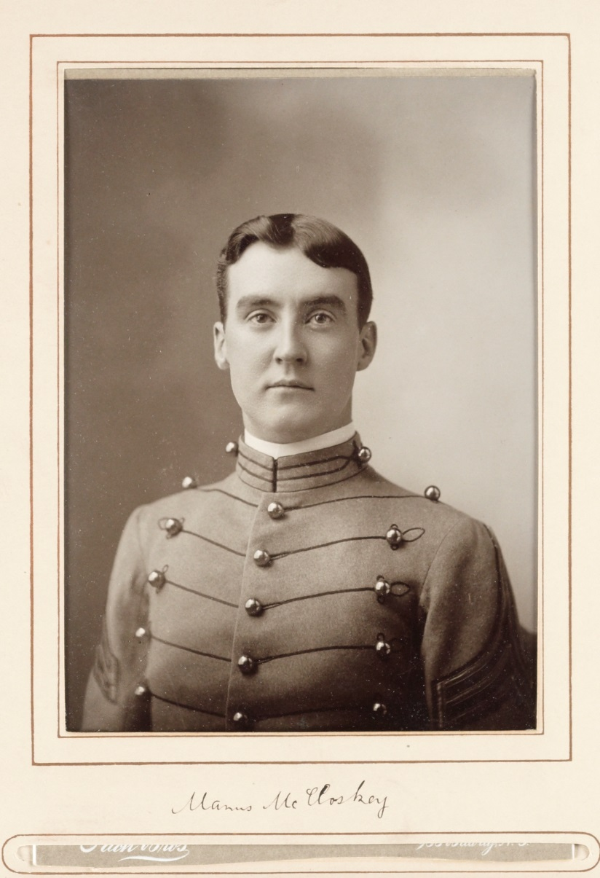
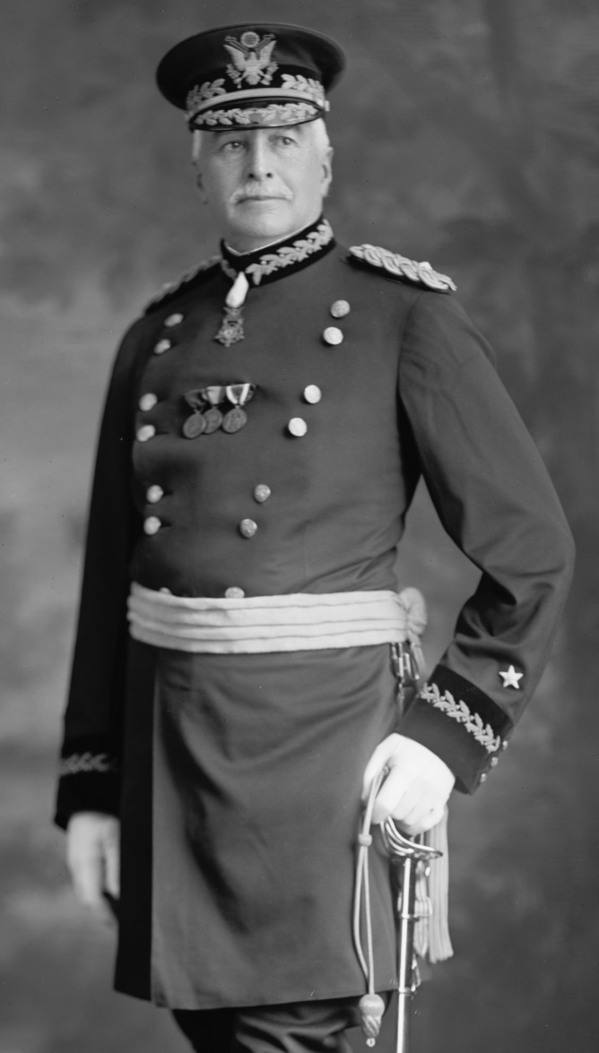
Who will train the Virginians?
MG Manus MacCLoskey
MG James “Galloping Jim” Parker
Notes:
The VANG was fortunate to have two well-known regular Army officers assigned to the units to teach Artillery, Infantry and Cavalry tactics
MacCloskey was a famous artilleryman. MacCloskey was a veteran of the Boxer Rebellion and had served in the artillery unit that broke open the gates to Peking. Taking over the provisional regiment in October, he drilled it in every aspect of field artillery operations from cannon firing to horse-breaking. Under his careful tutelage, the Guardsmen became proficient field artillerymen. By December, the regiment was declared fit for duty; the fastest of any of the newly formed units on the border.
Parker was a Medal of Honor recipient who trained the infantry and cavalry units.

Slide 8
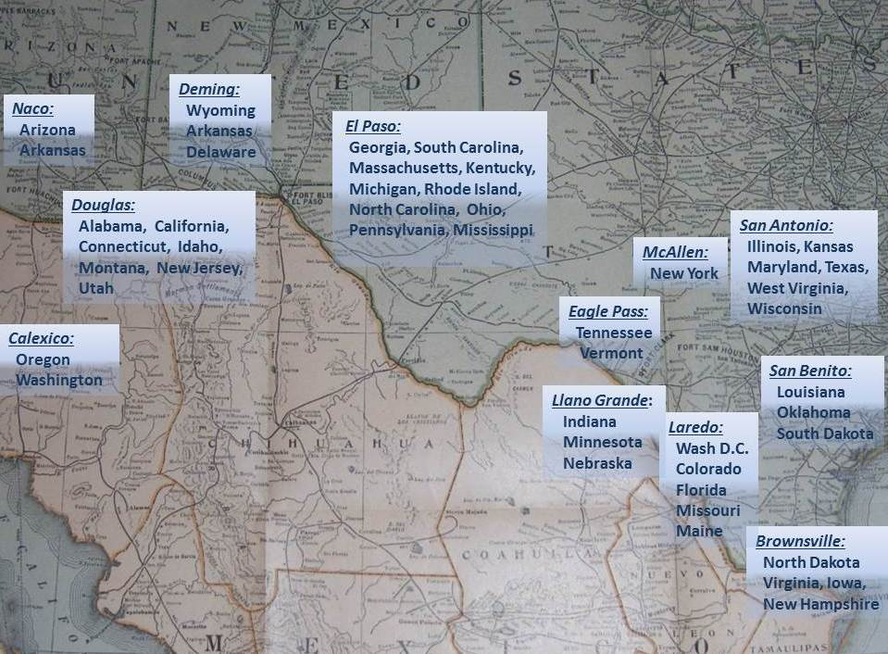
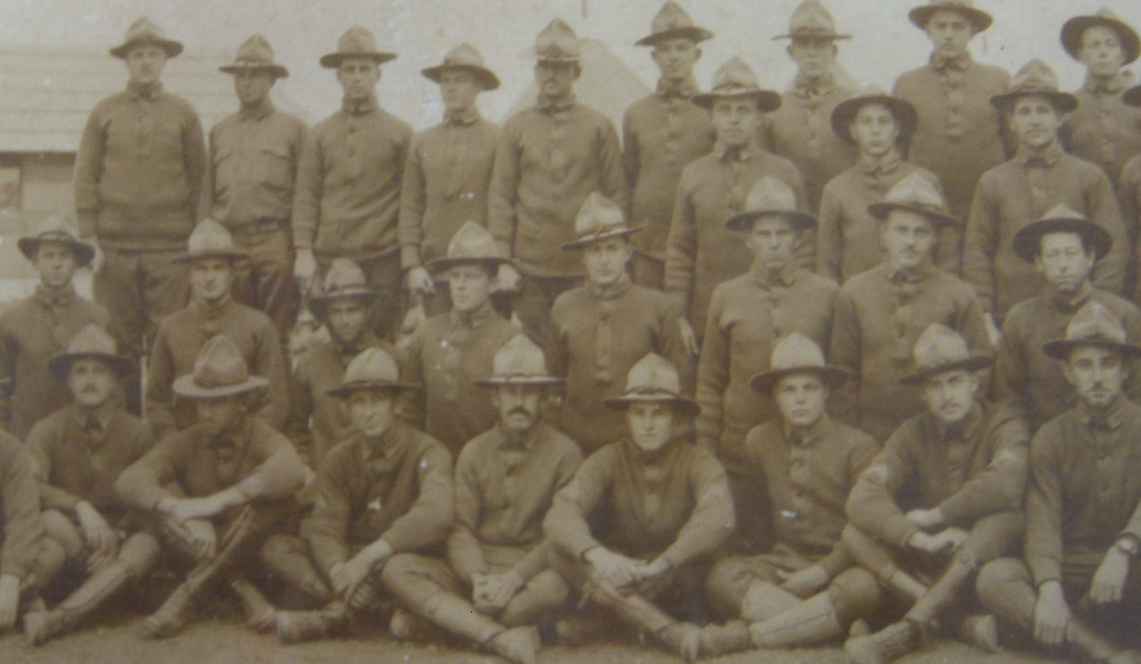
Notes:
Here you can see where all of the states were assigned on the border.

Slide 9
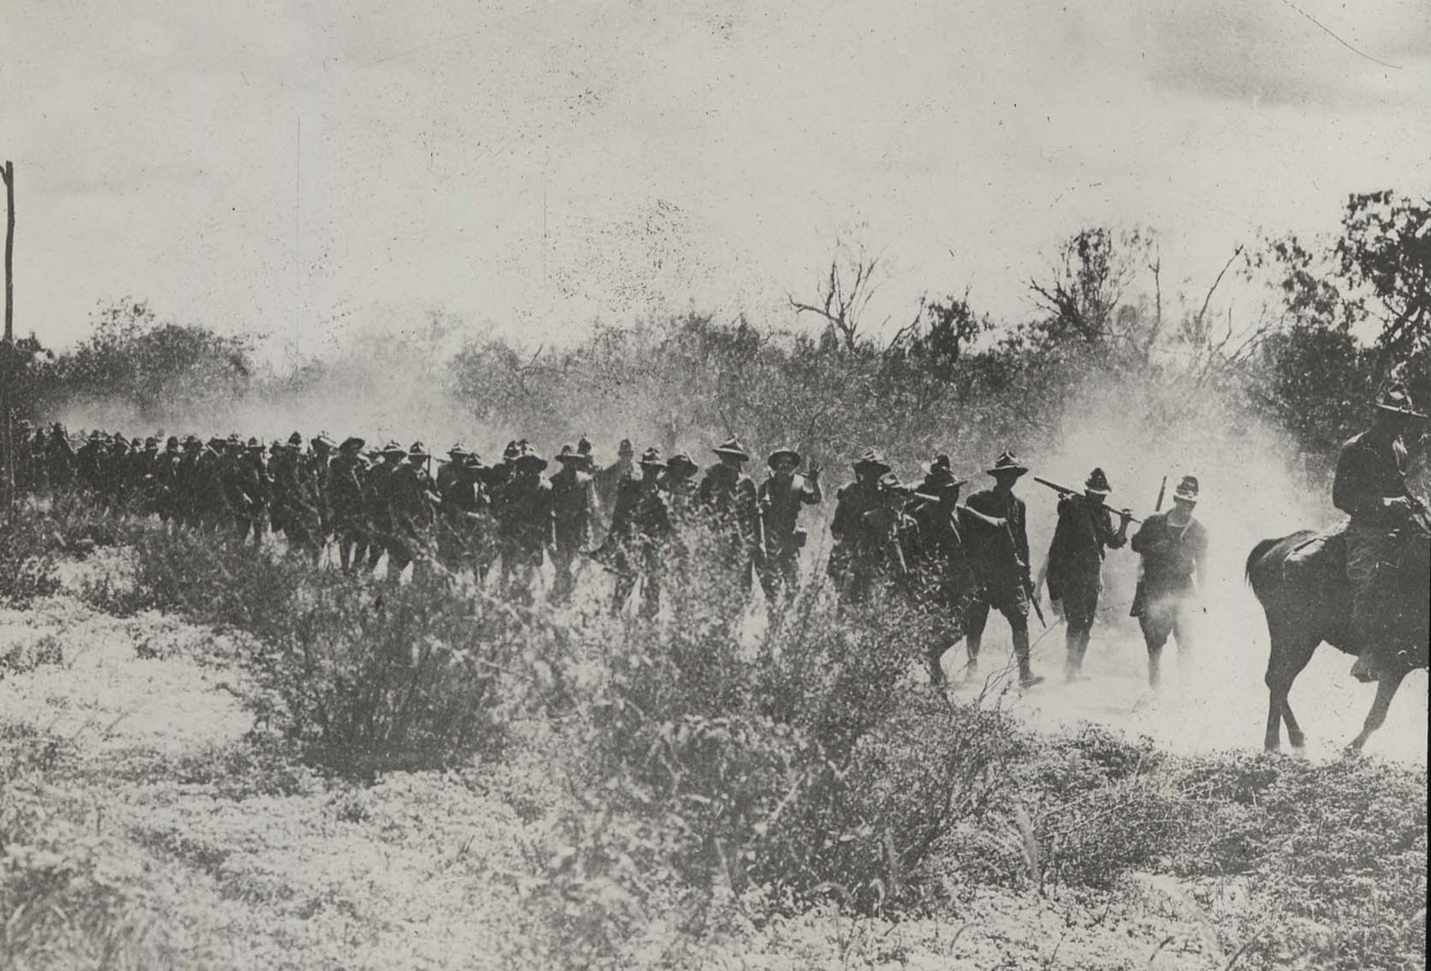
Origin of “Doughboys”?
Notes:
Perhaps the term Doughboys originated in the Mexican border campaign from the appearance of soldiers after their long dusty training marches and patrols

Slide 10
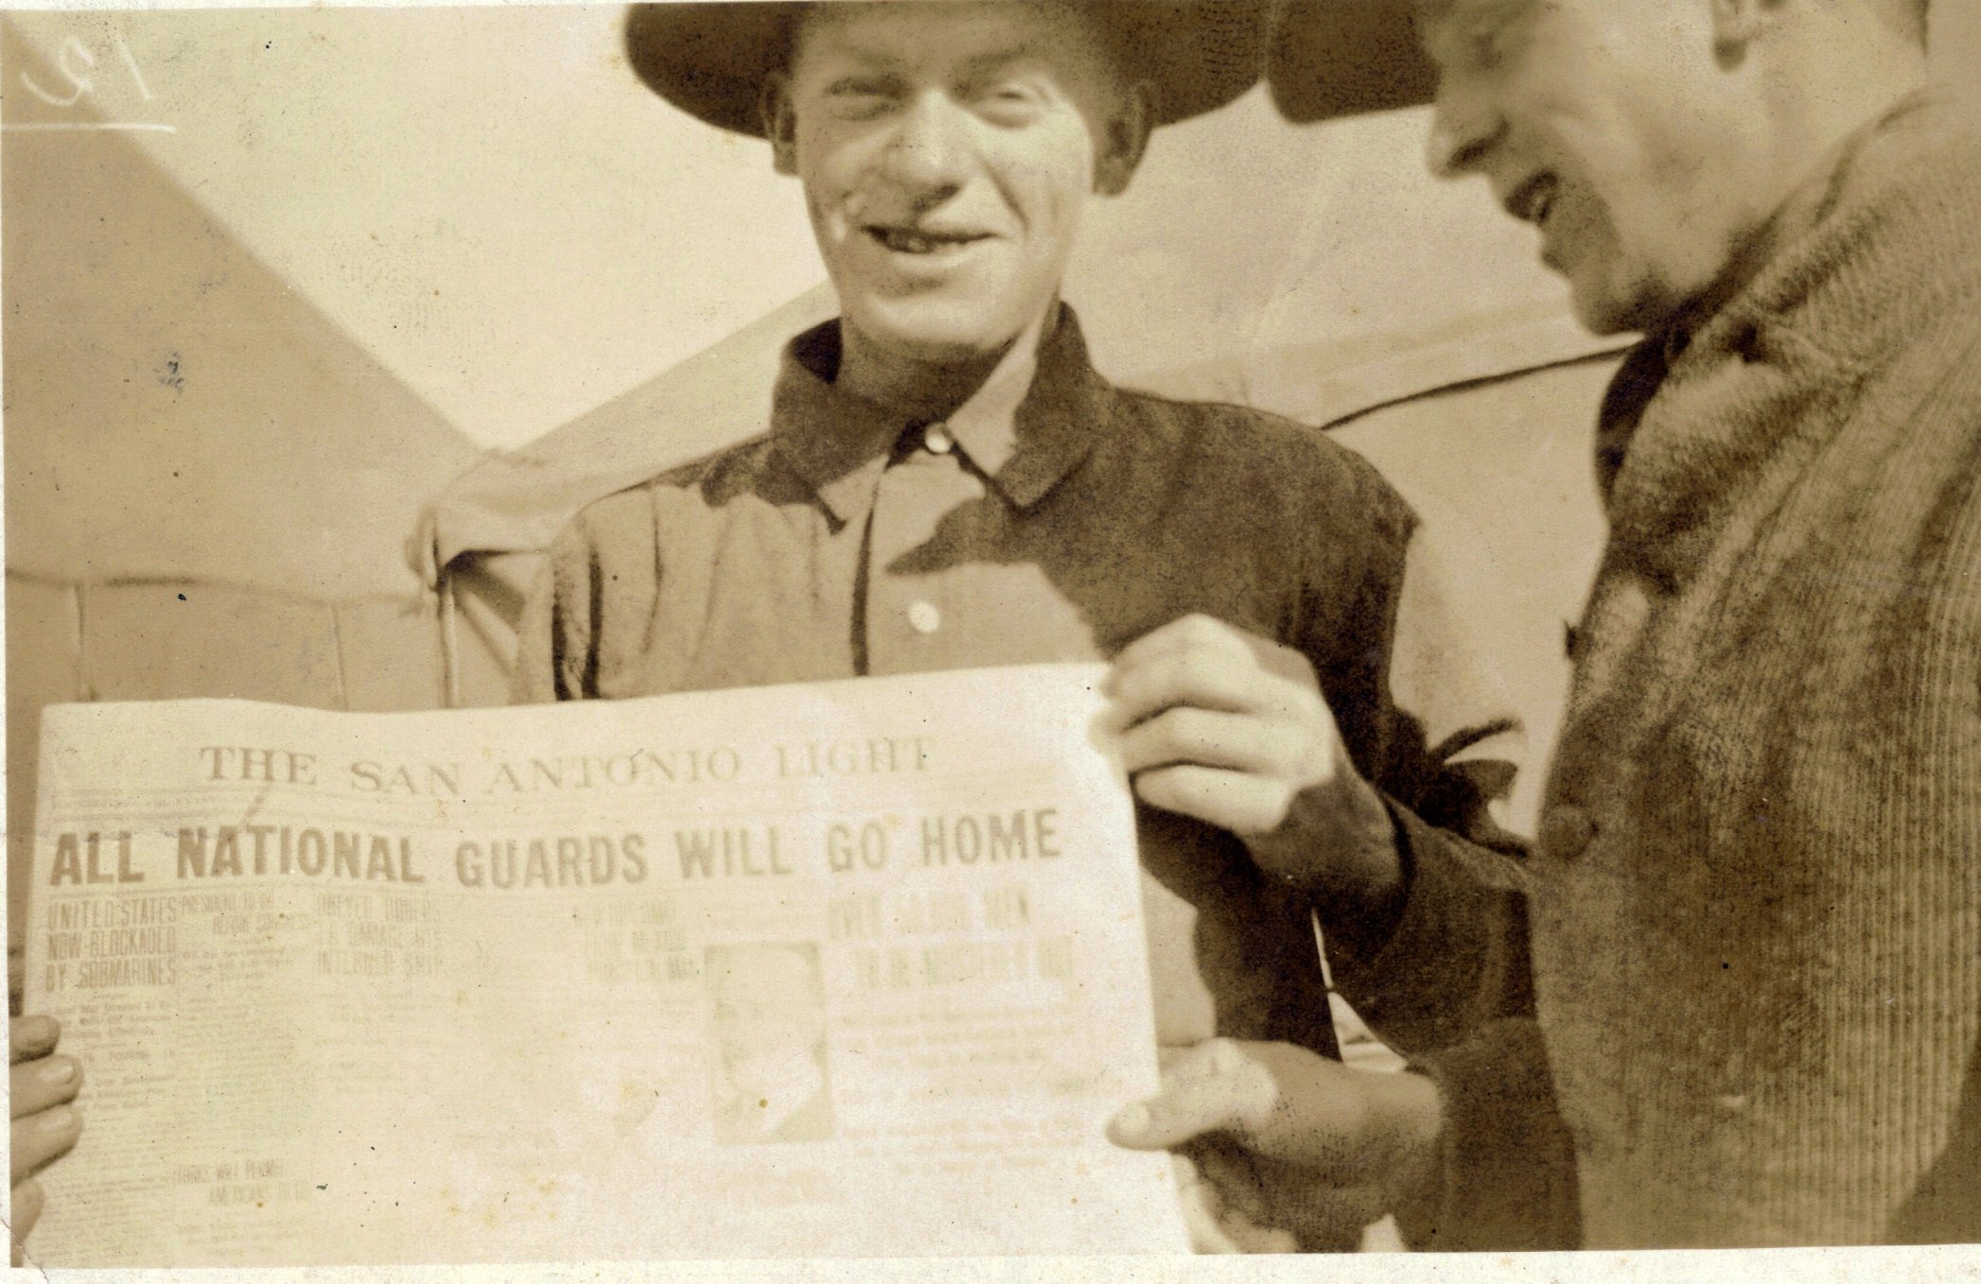
Every mission must end sometime…..
In mid-February 1917, General Funston received orders from Secretary of War Newton Baker to return all National Guard units to their home states.
Baker:“empathically that this movement of troops bore no significance whatever in connection with the present international situation.”
Notes:
By early 1917, with a war with German threatening, the President ordered all Guard units to return to their states.

Slide 11
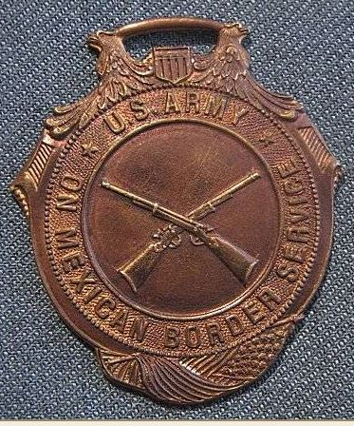
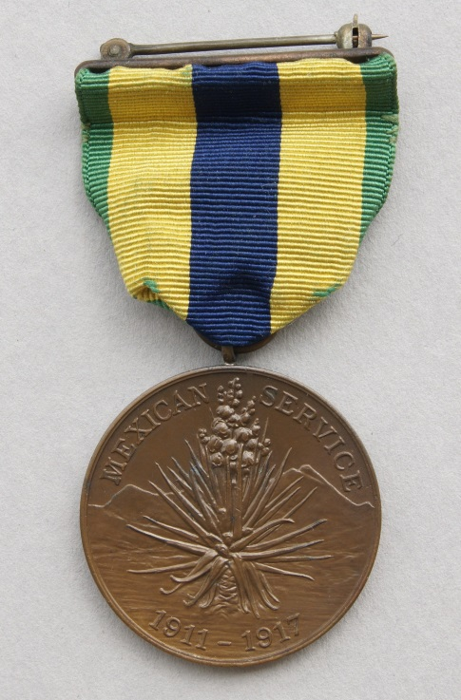
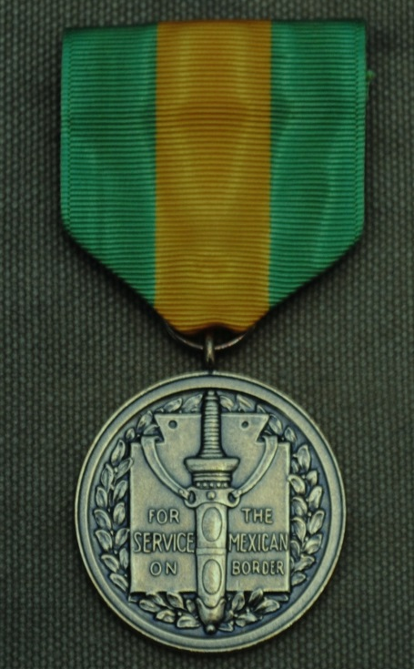
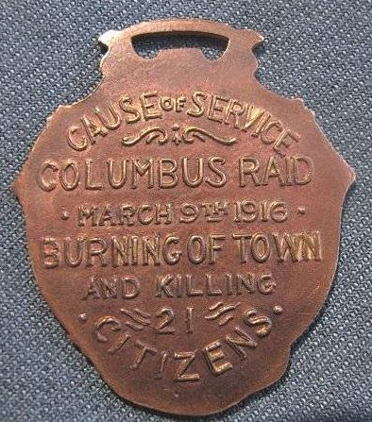
Welcome home…..but …
“This kind of warfare was very agreeable to the men. The duty given them was light and the experience was more like a summer vacation.”
Notes:
Many of the National Guardsmen who had served on the Mexican border had barely returned to civilian life before they again found themselves in uniform. The former Light Infantry Blues, now known as the 1st Virginia Cavalry, arrived home in Richmond in Mid-March of 1917, but the soldiers were not released from active duty. Instead, they were immediately assigned to patrol rail yards, bridges, dams and other vital infrastructure against sabotage by "enemy agents."
Note: the medal with the green ribbon and yellow stripe was issued to all Guardsmen who served on the Mexican border. The other medal is for the soldiers who actually crossed the Rio Grande and served in Mexico.

Slide 12
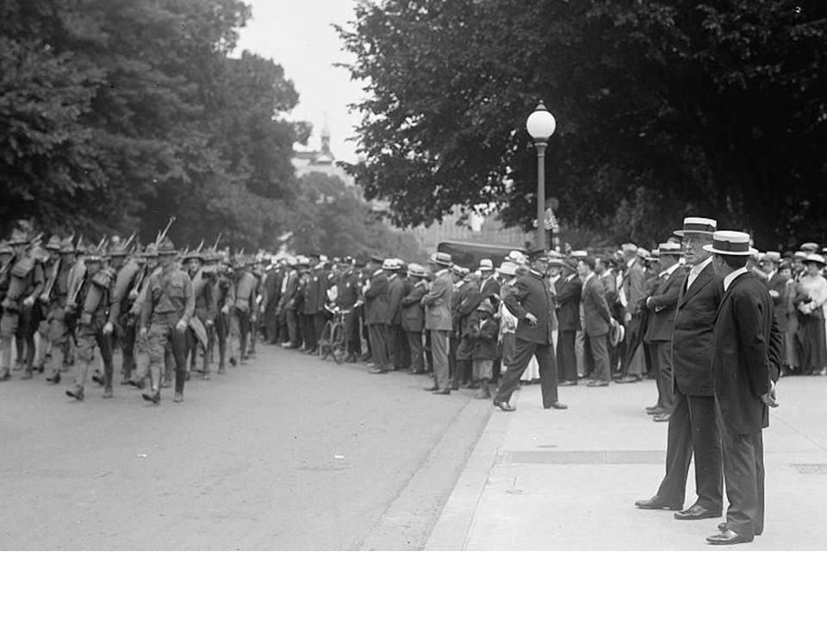
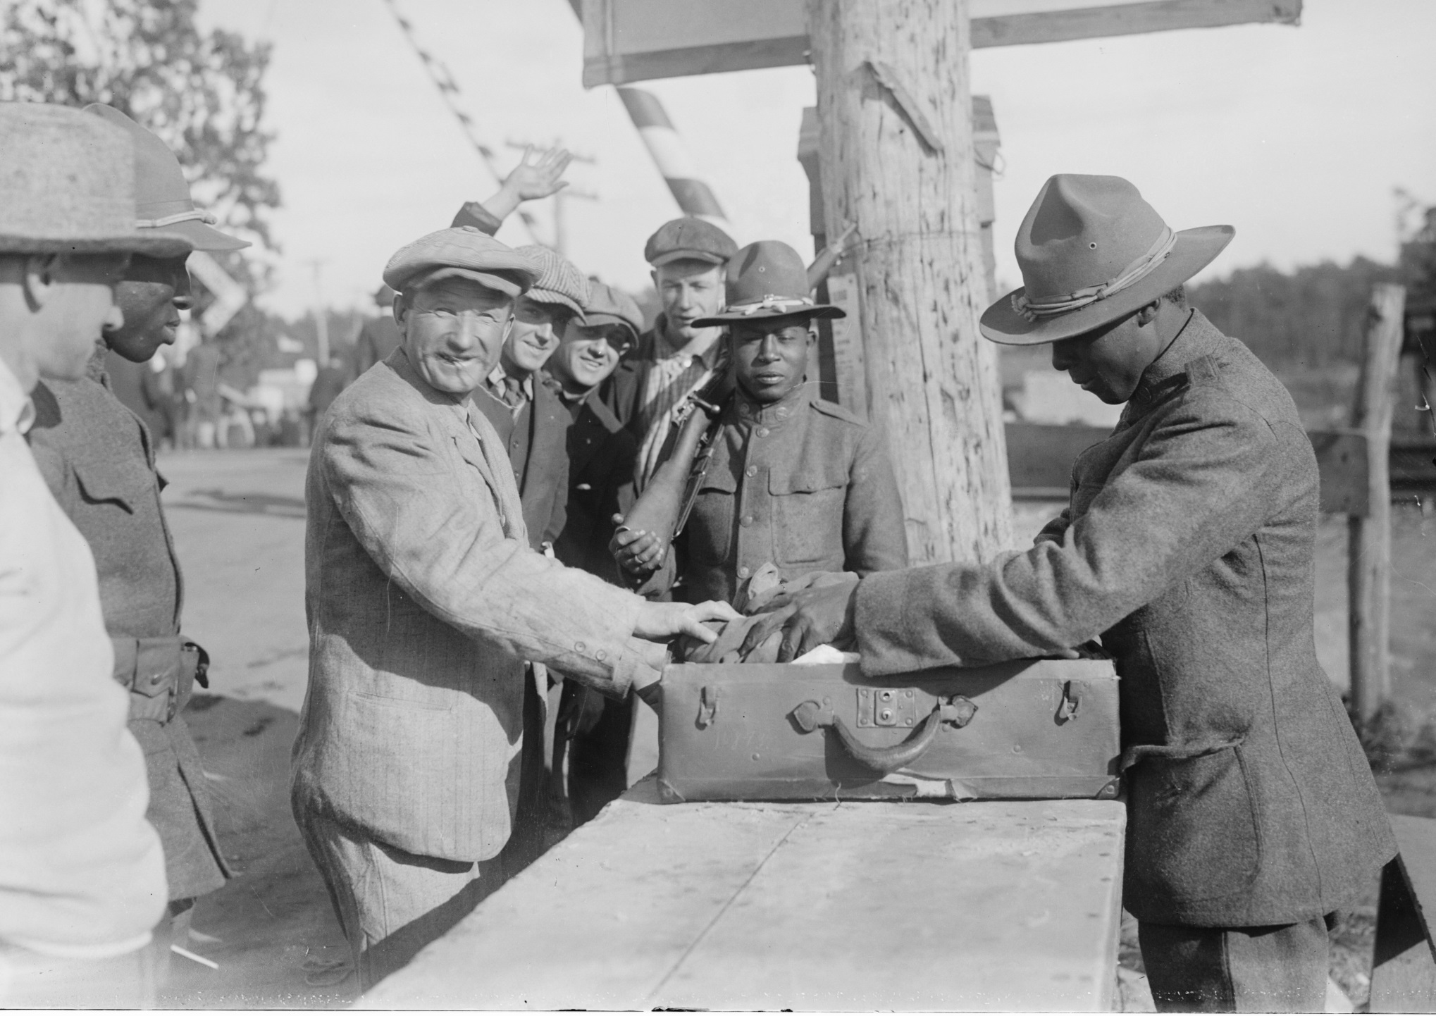
April 1917: War is declared against Germany, Austro-Hungary, Turkey
Notes:
War was declared on 6 April 1917 against Germany. With fears of German saboteurs and spys everywhere/
Note: Some of the African American National Guard units were activated to provide security in Washington DC because it was assumed there were no Germans serving in those units.
America declared war on Germany on 6 April 1917. By July the Virginia Guard was mobilized and moved to Camp McClellan, Alabama. Two Companies of Coastal Artillerymen were assigned to the 42nd “Rainbow” Division and would serve there for the entire war.

Slide 13
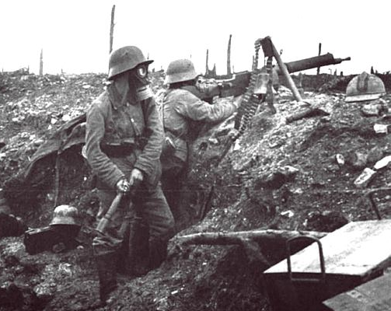
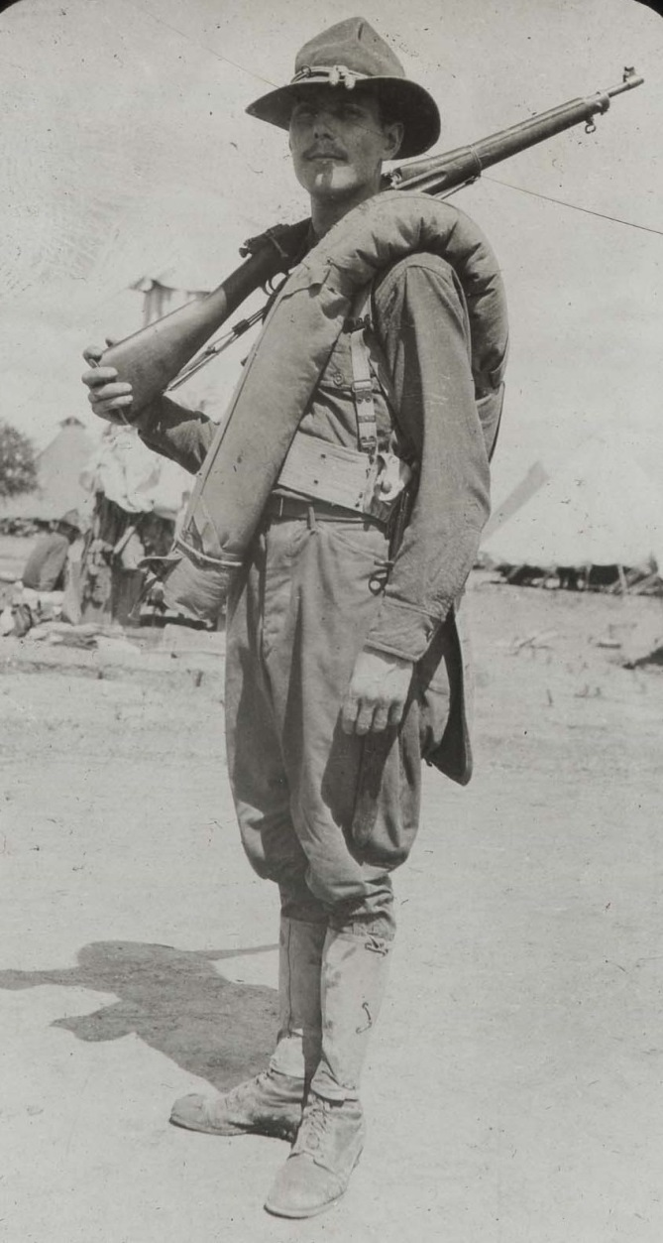
Service on the Border proves to be an excellent training event but much more will be required…
Before they will be ready
for the Western Front.

Slide 14
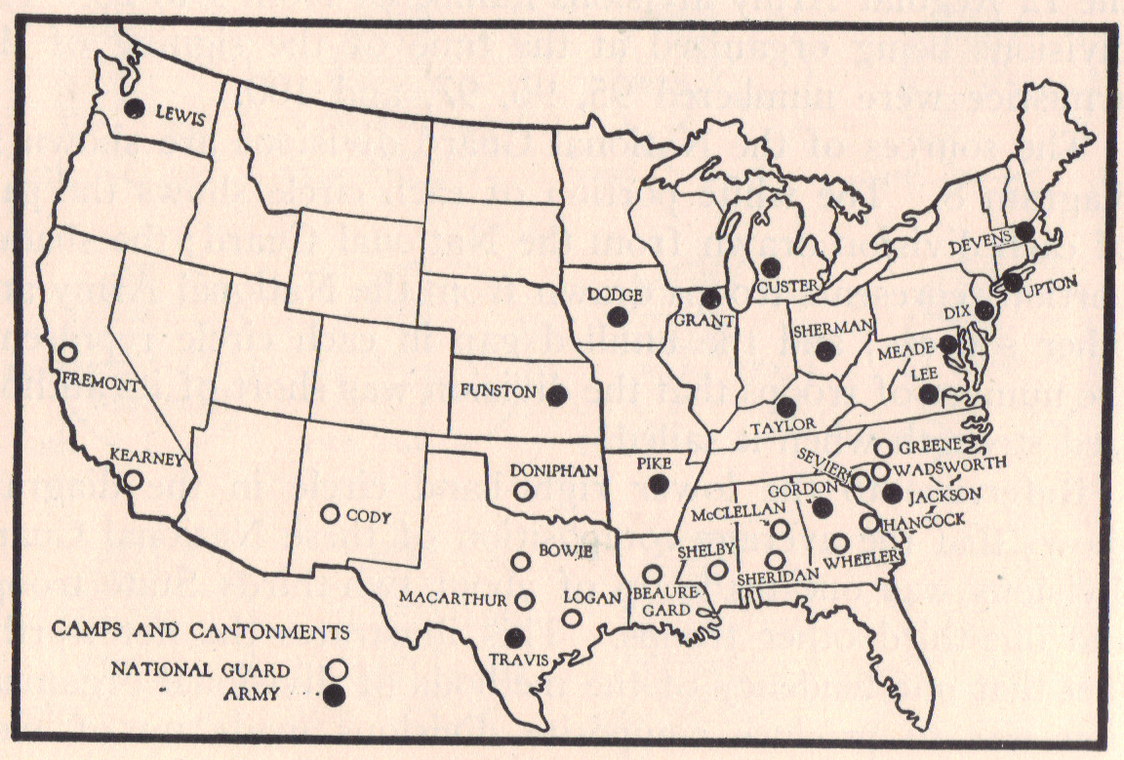
OK, we have a war on our hands, now what do we do?
….We better build an Army…a really big Army….
Notes:
Note that the National Guard camp sites are mainly in the south because the Guard units have tents and could camp out while training.
The National Army camp sites required buildings to house the new draftees

Slide 15
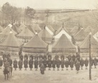
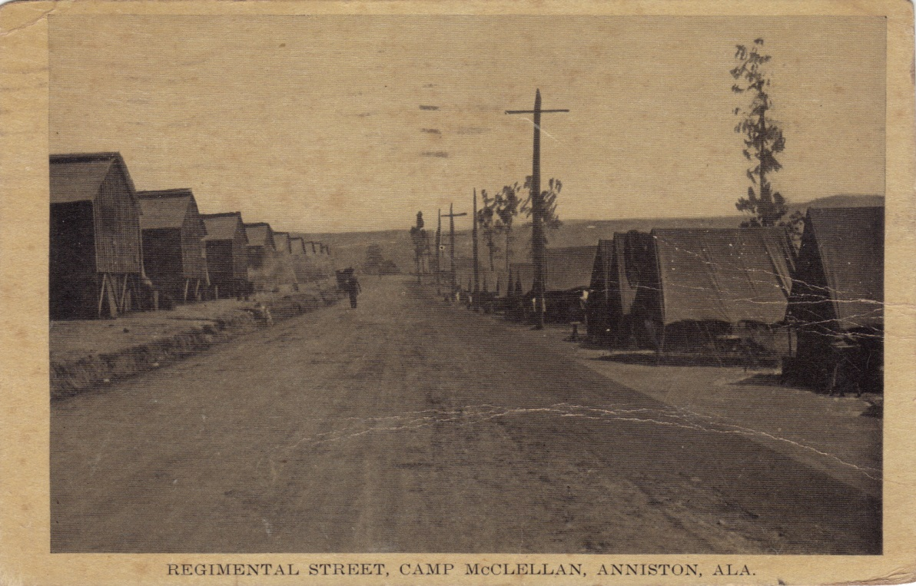
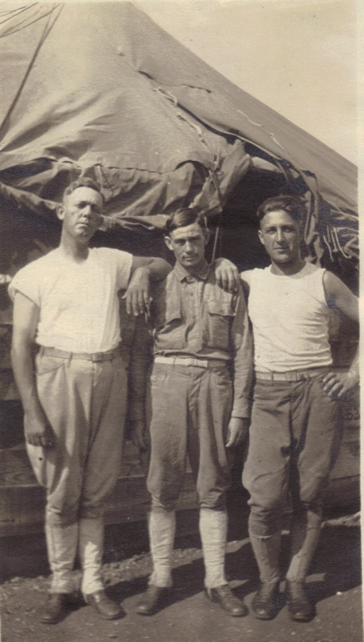
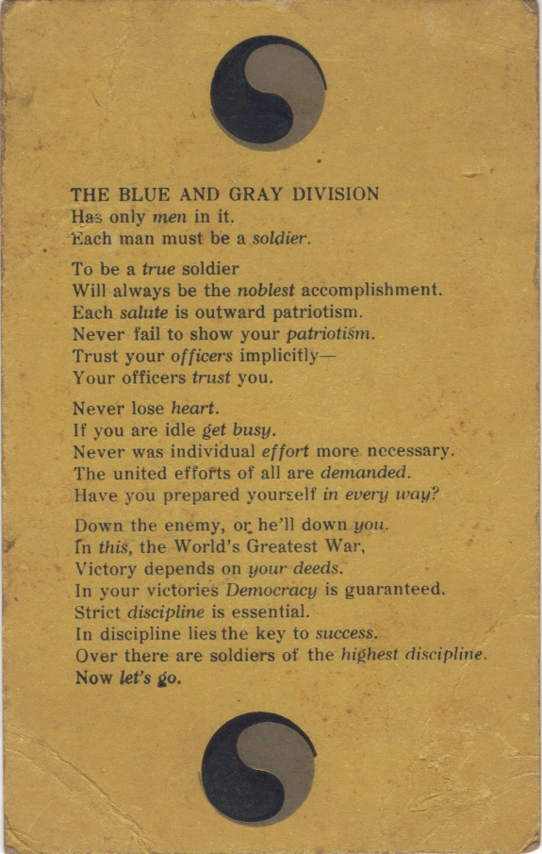
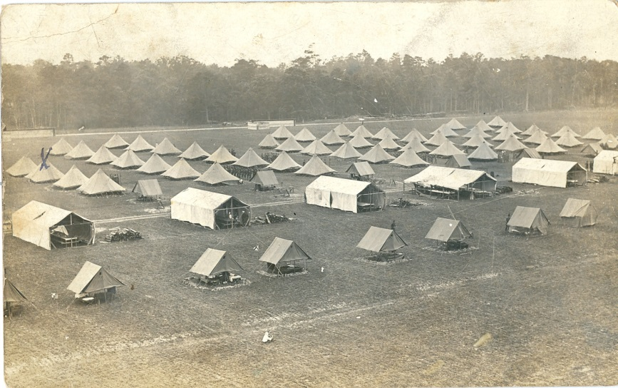
The 29th is born at Camp McClellan…
Notes:
Camp McClellan in Alabama, a southern post named for Union General George B. McClellan. Camp McClellan, located near Anniston, Alabama was established on 18 July 1917 as one of the many of training bases that were rapidly being constructed throughout the country to train America's Army for service in France.
Like the other training sites, Camp McClellan was comprised of hurriedly built buildings for headquarters, supply rooms, mess halls, latrines, and showers. The soldiers in the units had to use their tents as barracks.

Slide 16
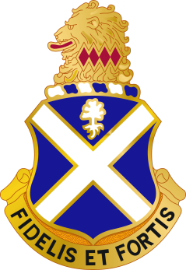
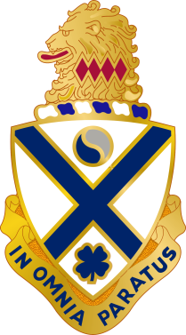
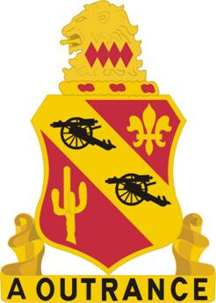
1917 at
Camp McClellan
29th
Division
57th Inf
Brigade
58th Inf
Brigade
Remount
Depot
104th
Fld Sig Bn
104th
Eng Rgt
54th FA
Brigade
113th
Inf Rgt
114th
Inf Rgt
115th
Inf Rgt
116th
Inf Rgt
Division Trains
104th Train HQ and
Military Police
104th Ammo Train
104th Motor Supply
Train
104th Sanitary Train
104th Engineer Train
110th
FA Rgt
111th
FA Rgt
112th
FA Rgt
Notes:
In this form there were 28,000 soldiers and officers assigned to the 29th Division
A fully equipped and manned American division placed 17,666 rifles, 72 field artillery pieces, and 260 machine guns in the field. Overseeing and commanding this massive organization was a major general and 978 other officers
The 29th was comprised of National Guard soldiers from Virginia, Maryland, Delaware ,and New Jersey
At McClellan, the Army combined the Virginia infantry regiments into one large regiment and redesignated it as the 116th Infantry, 29th Division. Virginia’s field artillery units were consolidated into the 111th Field Artillery, 29th Division. The 1st Virginia Cavalry was redesignated as the 104th Ammunition Train, 29th Division.
While at McClellan the 29th Division, composed of Guard units from Delaware, Maryland, New Jersey and Virginia, adopted the nickname it still carries today, “Blue and Gray.”

Slide 17
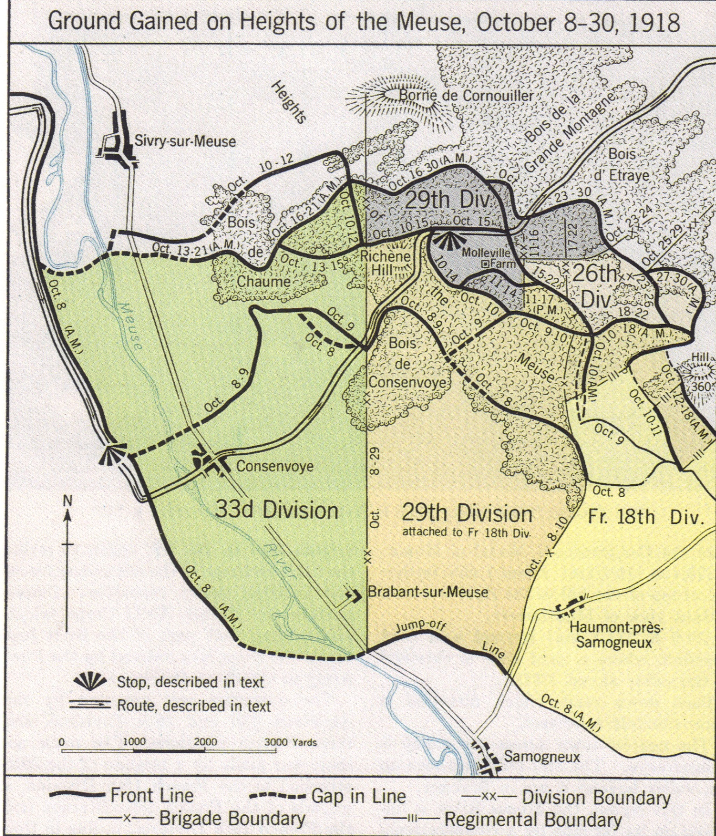
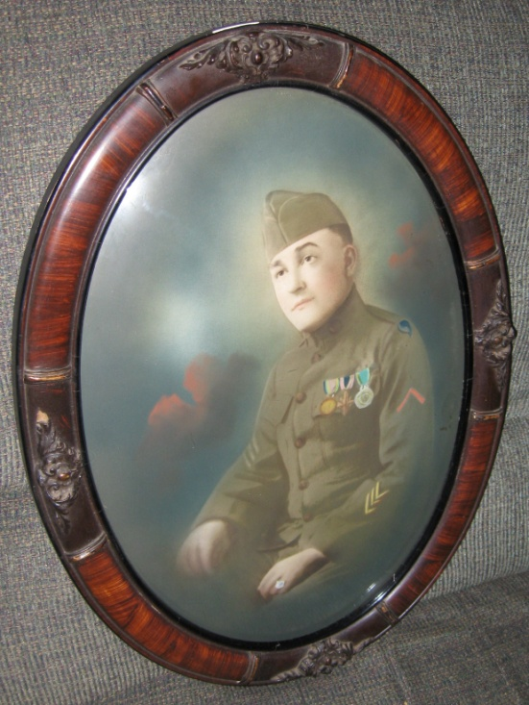
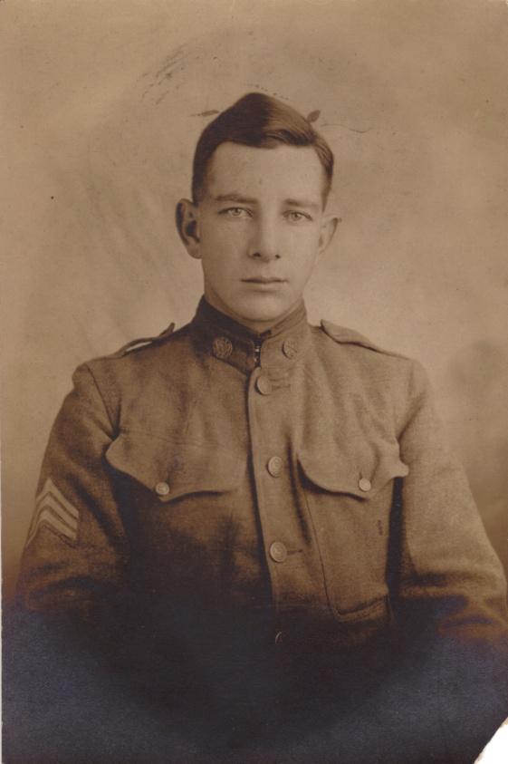
Notes:
The 29th was part of the Meuse-Argonne Campaign—the largest land battle in American history—there were 1.2 Million American soldiers in battler along with many thousands of logistical support soldiers.
On 8 October 1918, the 29th was an assault element in the great Meuse Argonne Offensive. In late October, the 29th was pulled out of the line to rest and prepare for the next attack. This attack was not needed as the war ended on 11 November 1918 with the Armistice.

Slide 18
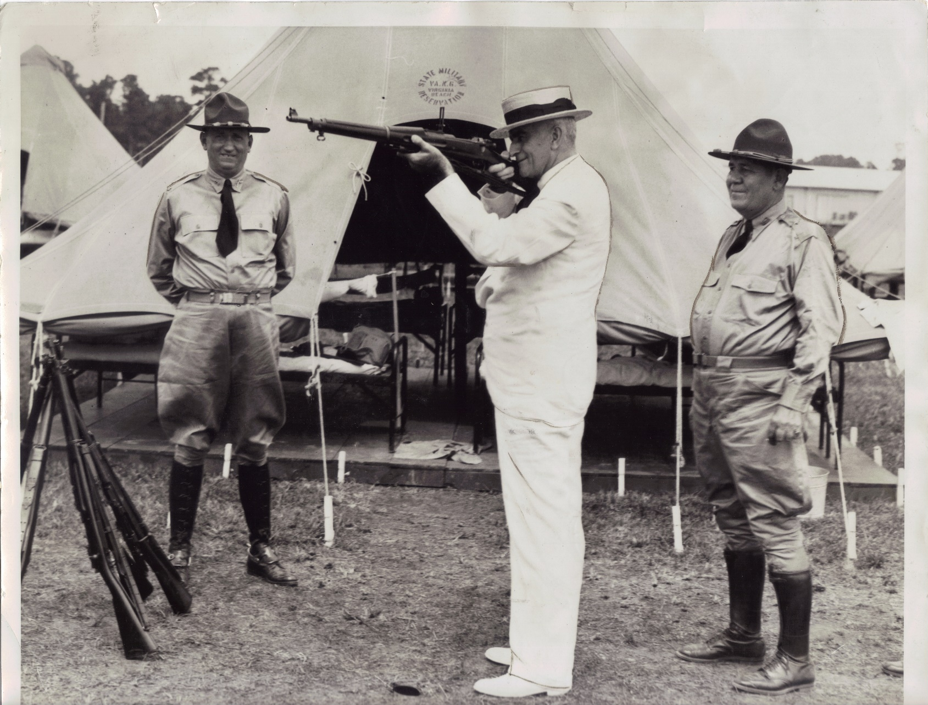
The Interwar period and a Division for all seasons:
Requires Continuous
Training
Notes:
The Adjutant General of Virginia, Gardner S. Waller (on right) shows the Governor how to aim a rifle.

Slide 19
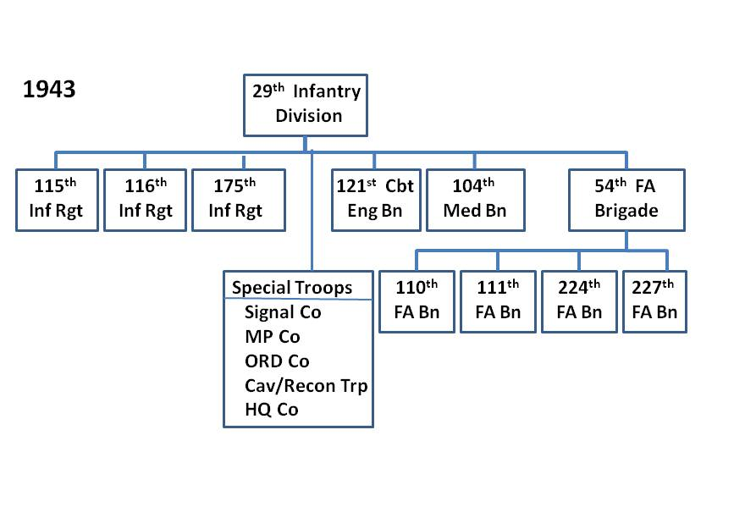
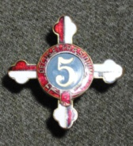
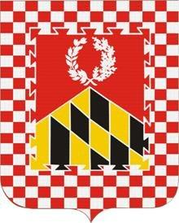
Notes:
After a lean interwar period, the Guard was again needed for the Second World War. The 29th trained at Fort Meade and then reorganized, losing the 176th Infantry and the 29th Tank Company to other units. The 116th remained in the 29th along with two Maryland infantry regiments. The 111th Field Artillery Regiment was broken into two parts; the 111th Field Artillery Battalion and the 227th Field Artillery Battalion,

Slide 20
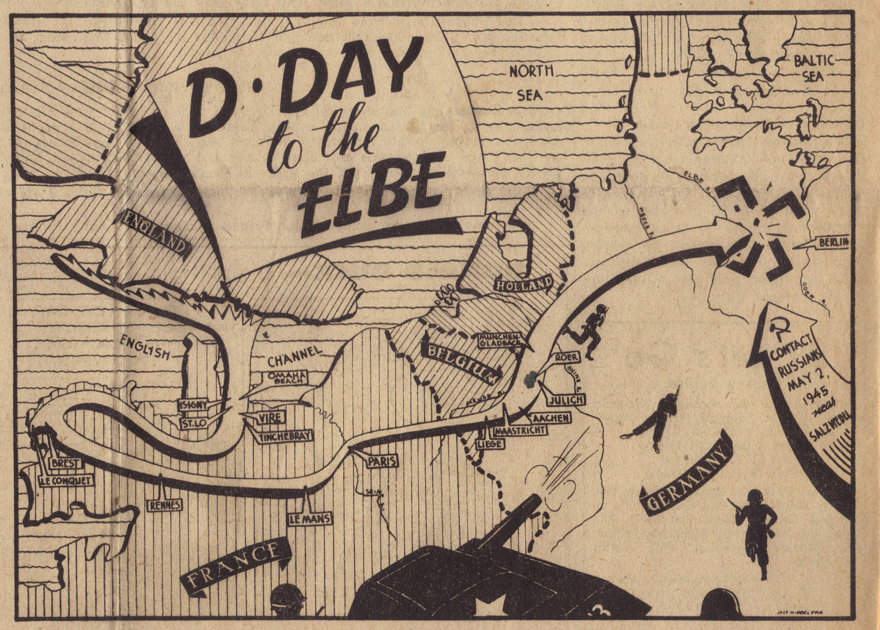
Amphibious Operations:
6 June 1944
Notes:
The 29th arrived in Britain in October 1942 and began training. The morning of 6 June 1944, to be known forever as “D-Day,” saw the largest invasion in history launched against five beaches on the coast of Normandy, France. One beach, codenamed “Omaha,” will always be remembered in Virginia history as “bloody Omaha” due to the more than 800 members of the 116th Infantry who were killed, wounded or missing during the amphibious assault. The 111th also took part on D-Day and lost most of their equipment in the attack. A total of 32 members of the 111th died trying to gain a foothold on Omaha Beach.

Slide 21
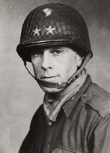
Return to Europe and
Preparing for D-Day

Slide 22
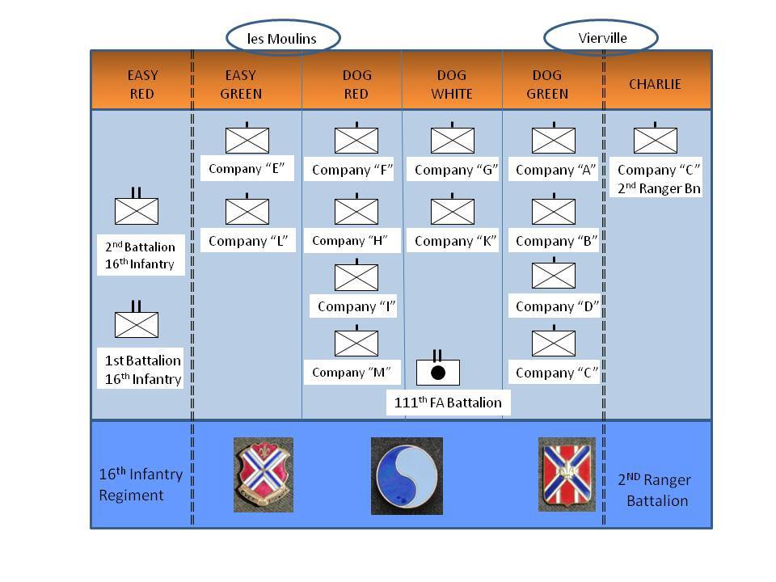
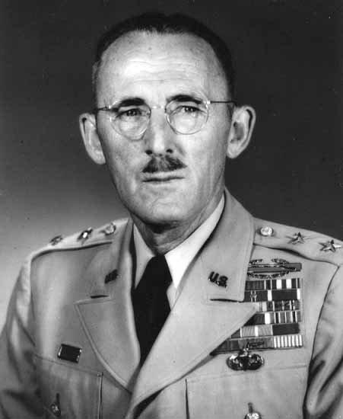
Charles Canham,
CO 116th RCT
6 June 1944

Slide 23
Bocage/Hedgerow
June-July 1944

Slide 24
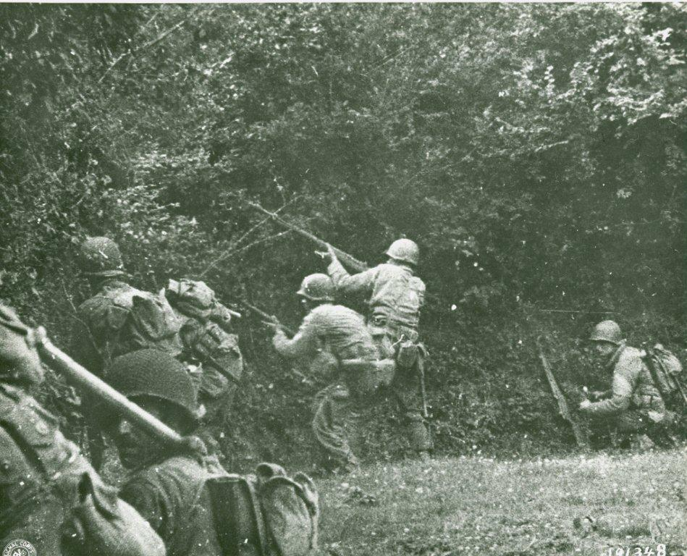
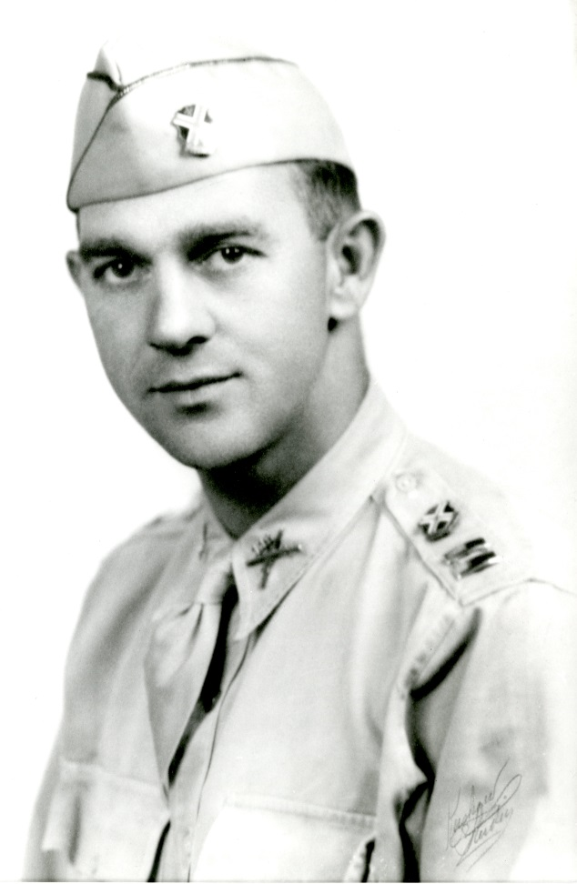
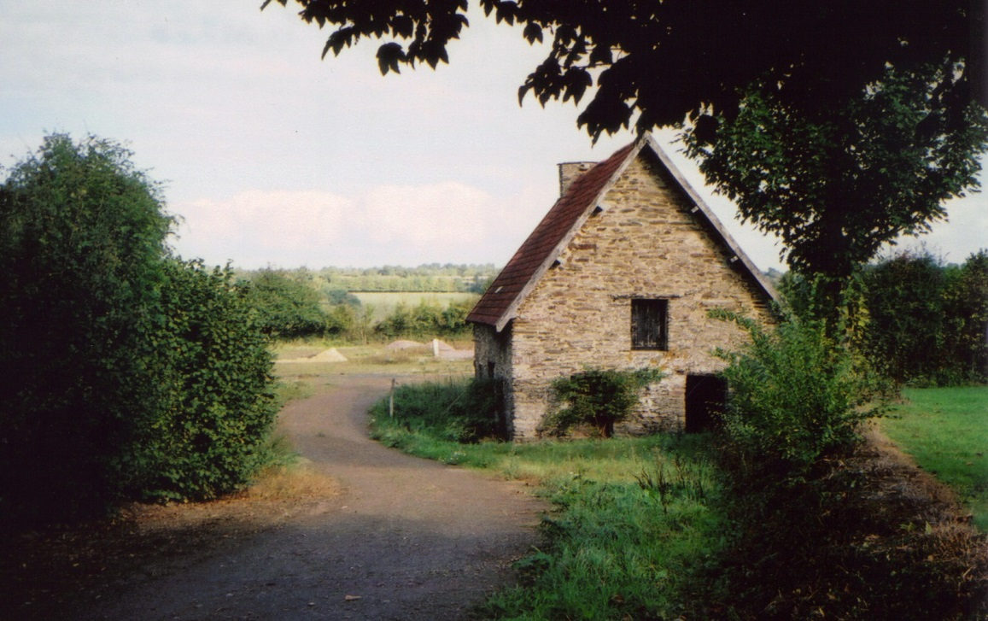
“The 29th Division has secured the city of St. Lo after forty three days of continual combat”
MG Gerhardt

Slide 25
Brest urban combat: August-September 1944
Notes:
By 22 August 1944 , the division was loaded onto trucks and headed westward into France's Brittany region. For some of the senior officers and NCOs of the 29th, it was the equivalent of entering a time warp. In 1918, much of the division had landed at the port of Brest before moving on to their first taste of the front lines in the Alsace region.
The quick movement of Patton’s forces through the area had cut off a number of German units in and around the city and port complex of Brest. The 29th had been chosen to take back the city of Brest from the German force that had been isolated there.

Slide 26
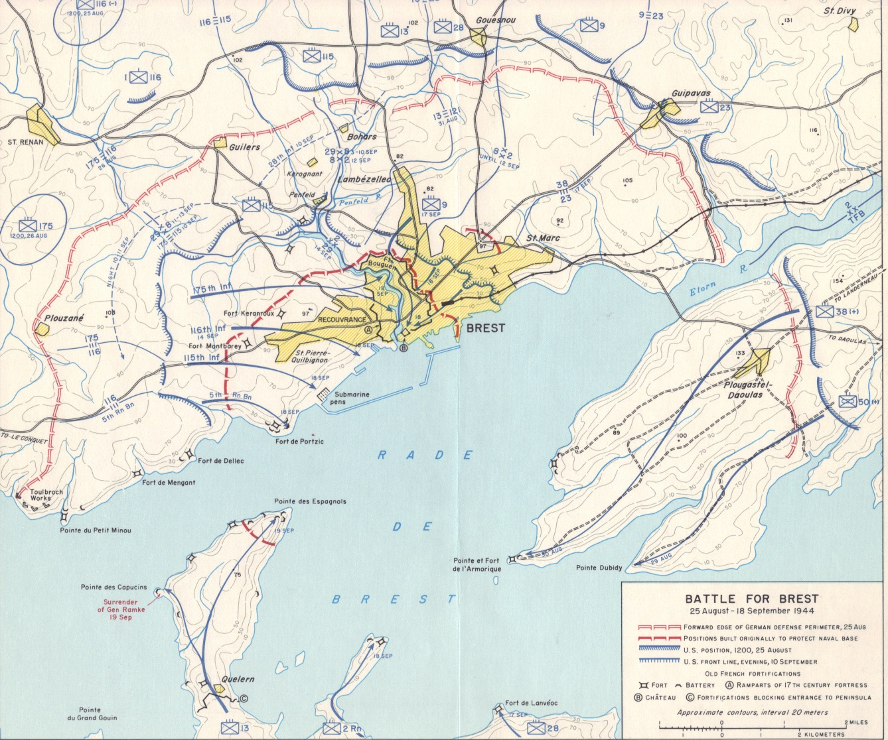
“These are my credentials.”
Notes:
The 29th Division, with the U.S. 8th Infantry Division on their left flank, continued to gnaw away at the German strong points.
Working with artillery support whenever possible, and making unsupported attacks when necessary, the 115th continued to drive towards the outskirts of the city itself.
By 9 September, the 115th had made the deepest penetration into “Fortress Brest,” but it had come at a high price; from 24 August to 10 September, the regiment had suffered 115 dead and 382 wounded.
By 18 September, even the most determined German defenders had finally had enough and began to surrender. Throughout the 29th’s sectors, the Guardsmen cautiously watched the approach of Germans with white flags. By 11 a.m., the fighting was over and the surviving Germans began to file out of their fortifications.
General Ramke, the German commander managed to escape across the bay to the Crozen Peninsula. He was captured there the next day by the 8th Infantry Division.
Ironically enough, the American officer sent to take Ramke’s surrender was Brigadier General Charles Canham, former commander of the 116th Infantry Regiment, and now the assistant commander of the 8th Infantry Division. When the rank-conscious Ramke arrogantly demanded to see Canham’s credentials before surrendering to him, Canham merely pointed to the American infantrymen standing nearby and said, "These are my credentials."

Slide 27
Patrolling, static defense and open terrain assaults: October 1944 – February 1945
Notes:
The move east commenced early on the morning of 24 September. The division was split into two groups. Some seven thousand of the soldiers would make the trip by train, while the rest would travel in long truck convoys.
By the end of September, the division was moving into defensive positions on the Dutch-German border. Their new mission was to relieve other U.S. Army units thus allowing them to move south, and join in the fighting taking place around the German city of Aachen.

Slide 28
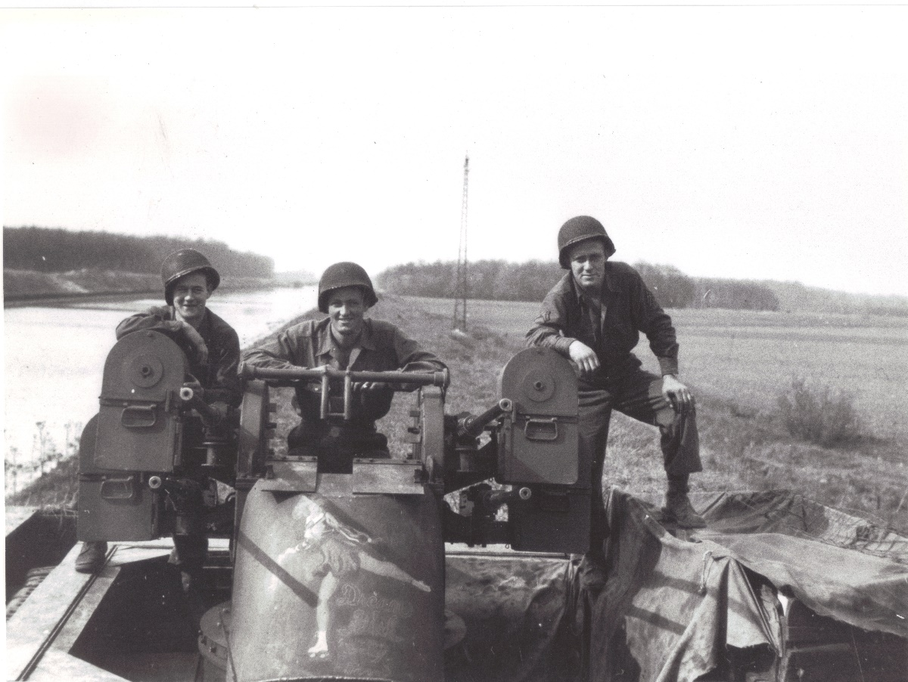
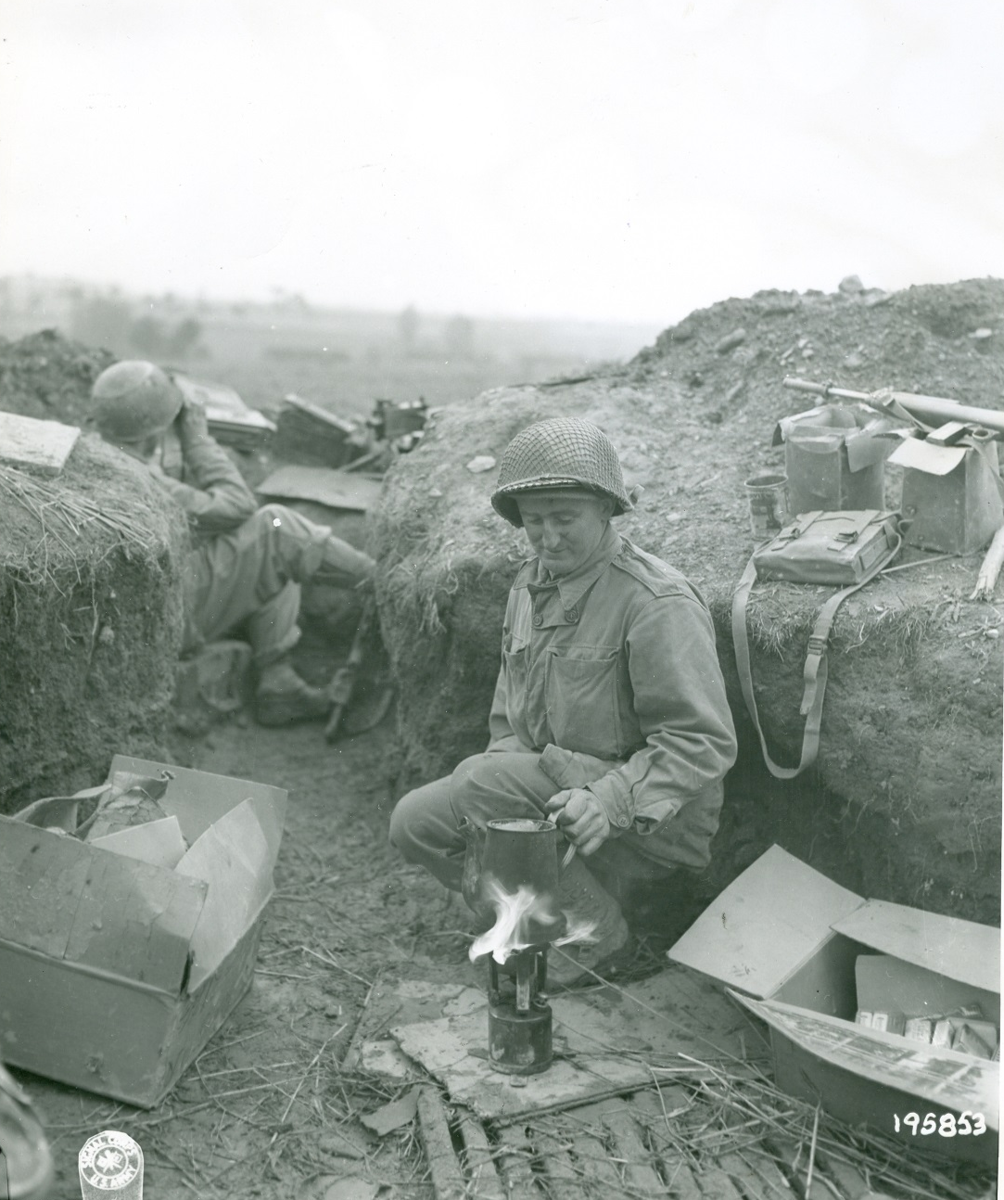
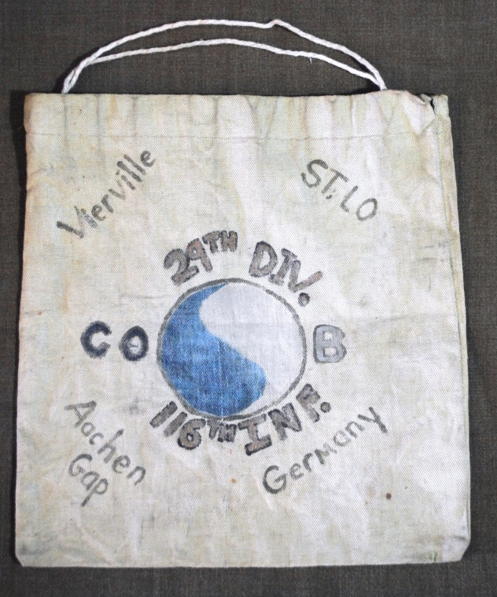
Notes:
November 1944 found the 29th holding a portion of the frontline facing eastward into the German Rhineland.
While it appeared that the Americans on the Roer plain were finally gaining the upper hand, a particularly nasty battle broke out in the town of Bourheim. Several of the 175th’s infantry companies were overrun while attempting to defend the recently captured town.
While the fighting around Bastogne and on the sidewalls of the Bulge was increasing, the 29th experienced a comparatively peaceful and uneventful Christmas Day.
Gerhardt was a far too aggressive leader to let his division spend all of their time in winter quarters and writing letters home. The 29th constantly sent small patrols across the river to reconnoiter the enemy’s positions and in an attempt to glean some intelligence into their planning. At least sixty patrols from the 29th braved the cold weather and German outposts to cross the Roer and scout for information during this period while the Battle of the Bulge continued.
On the morning of 23 February, they did. Using lightly armored amphibious vehicles known as “Alligators,” and some assault boats, the 115th and 175th finally crossed the Roer River.

Slide 29
Pursuit Operations:
March – May 1945
Notes:
Moving quickly now, the 29th continued its northward trek.
By the end of the month, they were outside their goal, the large industrial city of München-Gladbach. In a flanking maneuver, the 116th moved to cut off the city from reinforcements, while the 175th moved directly into the center of town.
The act of capturing the city had two immediate benefits for the victorious but tired riflemen of the 29th.
The overnight accommodations in a large German city were certainly more luxurious than what they were accustomed to. More importantly, the advance of other U.S. units past the city had pushed the 29th out of the front lines and into a rear echelon reserve. For the first time, some of the Blue and Gray began to think that they might actually survive the war.

Slide 30
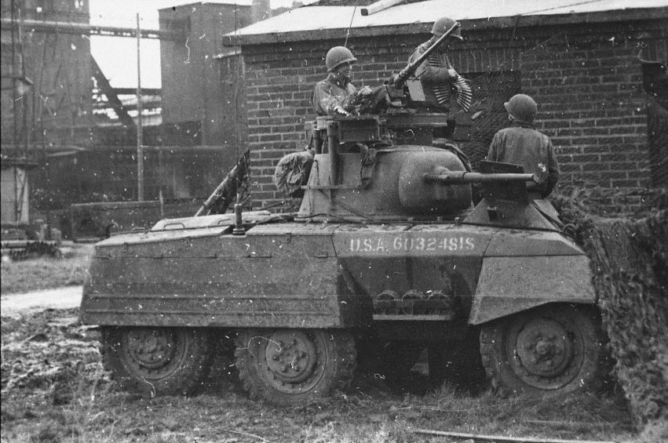
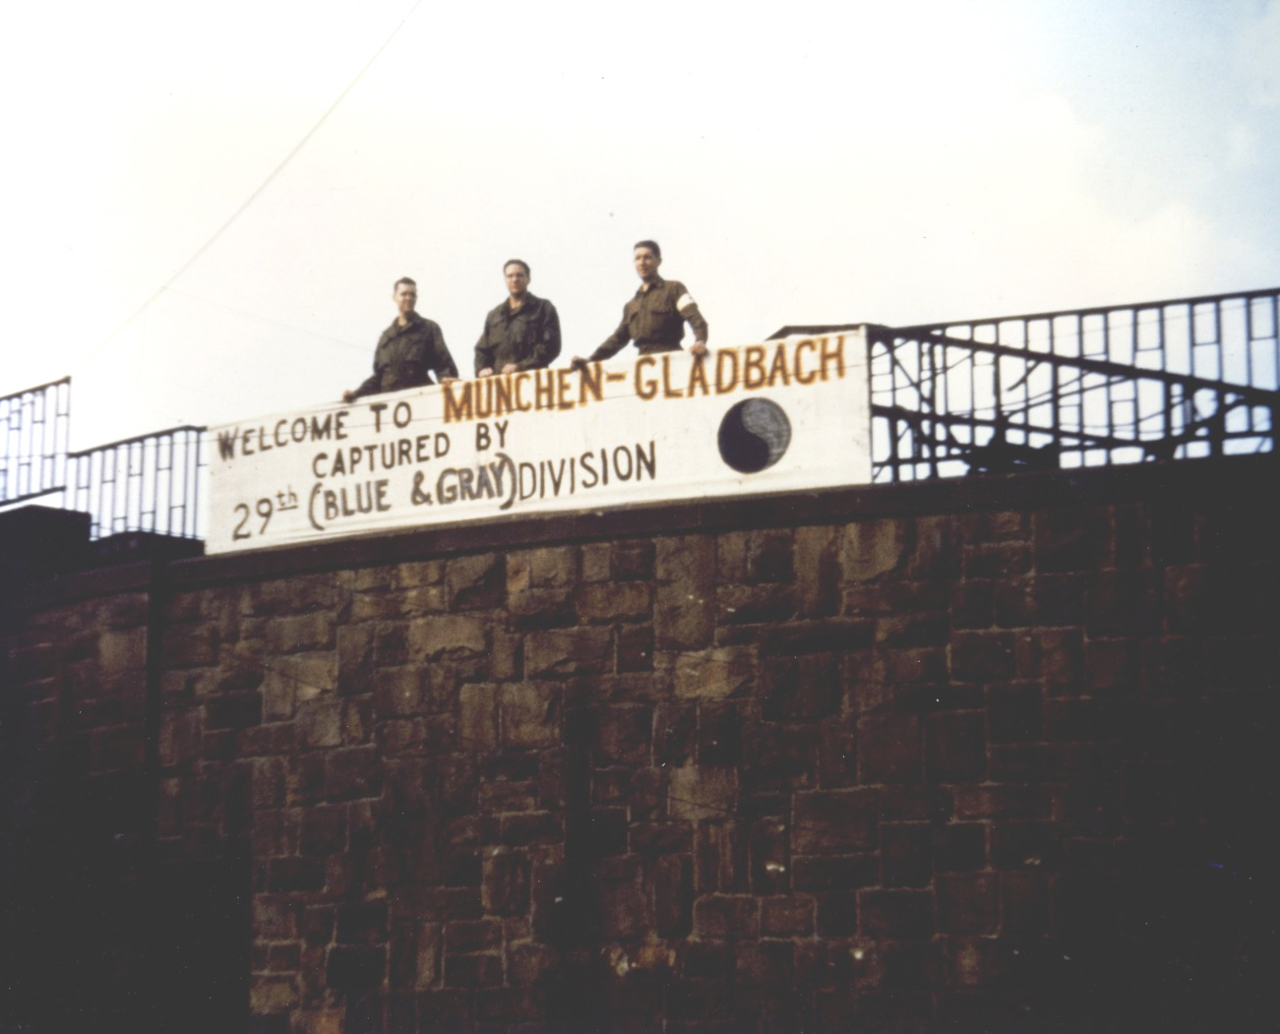
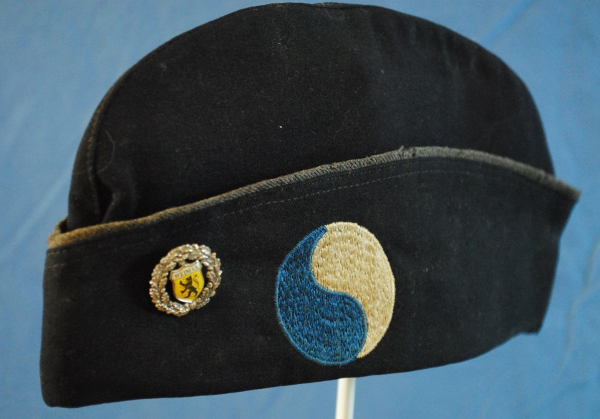
Notes:
On 17 April, the 29th was again ordered to move out. This time, the operation was to sweep in a north-easterly direction with the goal of rounding up all of the German soldiers west of the Elbe River.

Slide 31
Formal Occupation and Administration
of Bremen Enclave: May to December 1945
Notes:
During its 335 days in combat operations the 116th Infantry suffered 7,113 men killed, wounded or missing. The 111th Field Artillery Battalion lost 43 men killed in action.

Slide 32
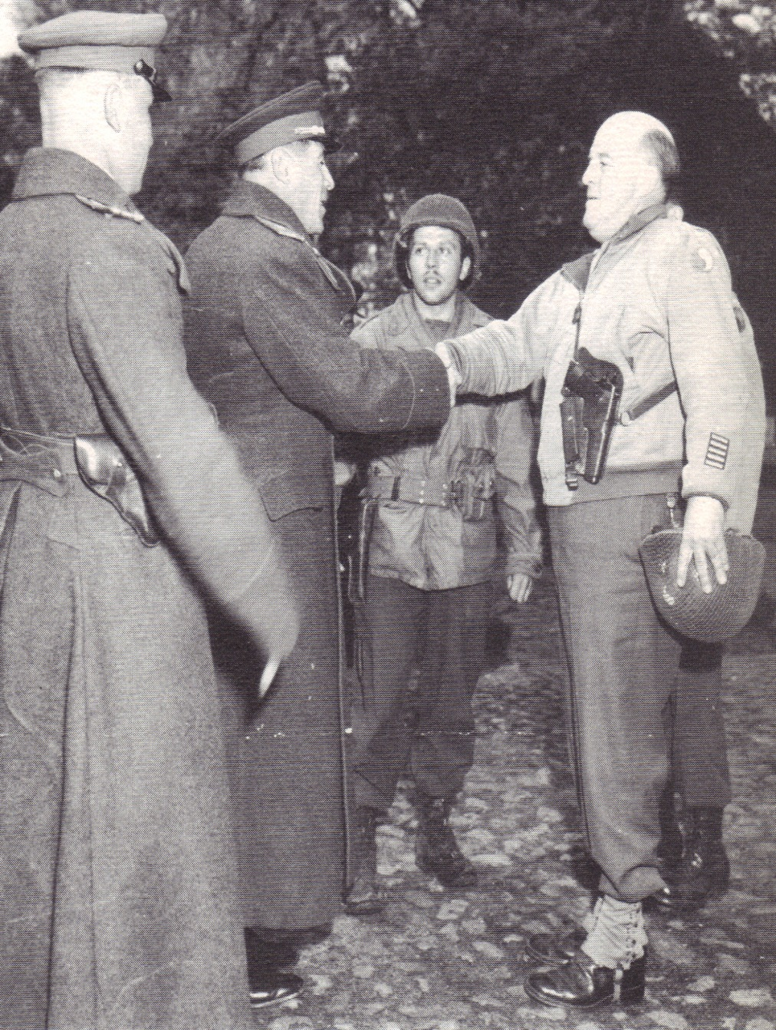
Notes:
On 3 May, a group of Russian soldiers crossed the river and were welcomed by the 29th. Later that evening, another group crossed and this time were led by a Russian major general. They were met by the Divisional Artillery Commander, Brigadier General William H. Sands, who presented them with gifts on behalf of General Gerhardt.
The 29th was now assigned to occupy and administer the area of Northern Germany, soon to become known as the "Bremen Enclave." Bordered on the north by the North Sea, the Enclave was a large sector that included two German ports, Bremerhaven and Bremen.
While in the course of moving northward to begin their duties in the Enclave, the 29th received word that Germany would surrender the next day. The war in Europe officially ended for the American forces with the signing of the surrender documents by the German representatives on 7 May 1945.
8 May 1945 has become known to the United States as V-E (Victory in Europe) Day.

Slide 33
Notes:
During the 43 years of the Cold War, many changes occurred in the Virginia Guard including the addition of the 149th Fighter Squadron, the Commonwealth’s first Air National Guard unit. No Virginia Guard unit fought in the Korean War or in Viet Nam but some units were activated during the Berlin Wall crisis in 1961.

Slide 34
Notes:
In 1964, more changes took place. For the first time in many years, Guard units participated in a large scale exercise with their active Army counterparts.
Although there were a few Guard units that served in combat, for most Guardsmen to go to Viet Nam, required them to volunteer for active duty and leave their Guard unit to serve on active duty. Perhaps as many as a thousand officers did just that during the course of the war.
African-Americans were recruited into the Virginia Guard the late 1960s and the first female soldier joined in 1973.

Slide 35
Notes:
In 1948 the Air National Guard was formed and the units in Virgiinia were equipped with P-47 fighter aircraft.

Slide 36
Notes:
While the Total Force Concept was of obvious benefit to the Guard, there were also two immediate benefits to the Active Army; it not only transferred a large number of logistics, combat arms, and specialized units (such as railroad operating or bridge building companies) into the Reserve Components, it also ensured that there would be local political support for the Army during any overseas military campaigns or deployments.
The importance of obtaining “home town” support became crystal clear during the publically-supported deployments of National Guard and Reserve units for Desert Shield/Desert Storm and the post-9/11 campaigns.

Slide 37
Notes:
Virginia and Maryland, National Guard units were activated and sent to Saudi Arabia to participate in Operation Desert Shield and Operation Desert Storm. For the most part though, these were non-divisional units that provided the specific capabilities requested by the senior Army commanders in the Persian Gulf.
Two truck companies, two engineer headquarters companies, a helicopter medical evacuation detachment, one company of military police and another of personnel services plus a military history detachment of the VANG served in the desert.
In total, 710 VANG personnel (including 105 females) served in theater.
After the Gulf War Virginia Guardsmen were deployed to the Sinai, Bosnia, and Kosovo for “Peacekeeping” missions.

Slide 38
And the beat goes on……
Notes:
On 11 September 2001 without warning, the United States was again at war. It is a fair assessment to say that the attacks on 9-11 truly closed out the 20th century for the 29th Infantry Division.
As a result of these attacks, the U.S. military, started the new century with a now direct war on global terrorism that continues today with little end in sight. In the years since 11 September 2001, the soldiers of the 29th Infantry Division have taken their places in the frontlines with the other famous units of the American military in fighting the long war.
After the attacks, the VANG provided security to government installations and critical infrastructure as well as flying security patrols.
In early 2002 approximately 70 soldiers of Virginia’s Company B, 3rd Bn, 20th Special Forces Group, were mobilized and deployed to Afghanistan. Captured enemy combatants were brought to the U.S. Naval Base at Guantanamo Bay, Cuba, for detention. To guard the base the 2nd Bn, 116th Infantry was mobilized on 2 November 2002.

Slide 39
The Red Dragons (1/116th Infantry) on the border.
Notes:
In 2003 the U.S. invaded Iraq to locate and destroy “weapons of mass destruction.” Three VANG units were in theater during the Iraq invasion, two in the initial attack, and the third entering Iraq later.
The HHD, 1030th Engineer Battalion, and the 1032nd Transportation Company accompanied the invasion forces entering Iraq. In September 2003, as the situation in Iraq deteriorated, 300 Air Guard personnel from the 192nd Fighter Wing, along with several of the unit’s F-16 fighters, deployed to Qatar and the pilots flew combat cover missions over Iraq. Over the intervening years, several Air Guard units served in Iraq or were split between Iraq and Afghanistan.
The 192nd Security Force Squadron served in OIF in 2006. From late 2006 into early 2007 the 203rd RED HORSE flight served in OIF, with elements also in OEF performing various construction missions.

Slide 40
Refurbishing the past
Notes:
Help us preserve and protect the Virginia National Guard’s history ….your history..

